Slide 1
Kubernetes Container Orchestration Infrastructure Management

Slide 2
Introduction
Kubernetes is an open-source container orchestration platform, crucial for scalable ML platforms.
It enables organizations to deploy and manage machine learning workloads at scale, ensuring high availability, scalability, and optimal resource utilization.
In this chapter, we will explore Kubernetes' core concepts and components that form the foundation of ML infrastructure.

Slide 3
Containers Overview
Containers are isolated environments that package software and its dependencies for consistent deployment.
Containers are more lightweight and portable compared to virtual machines as they share the same OS kernel.
Popularized by Docker, containers are now the standard for deploying applications in microservices architectures.

Slide 4
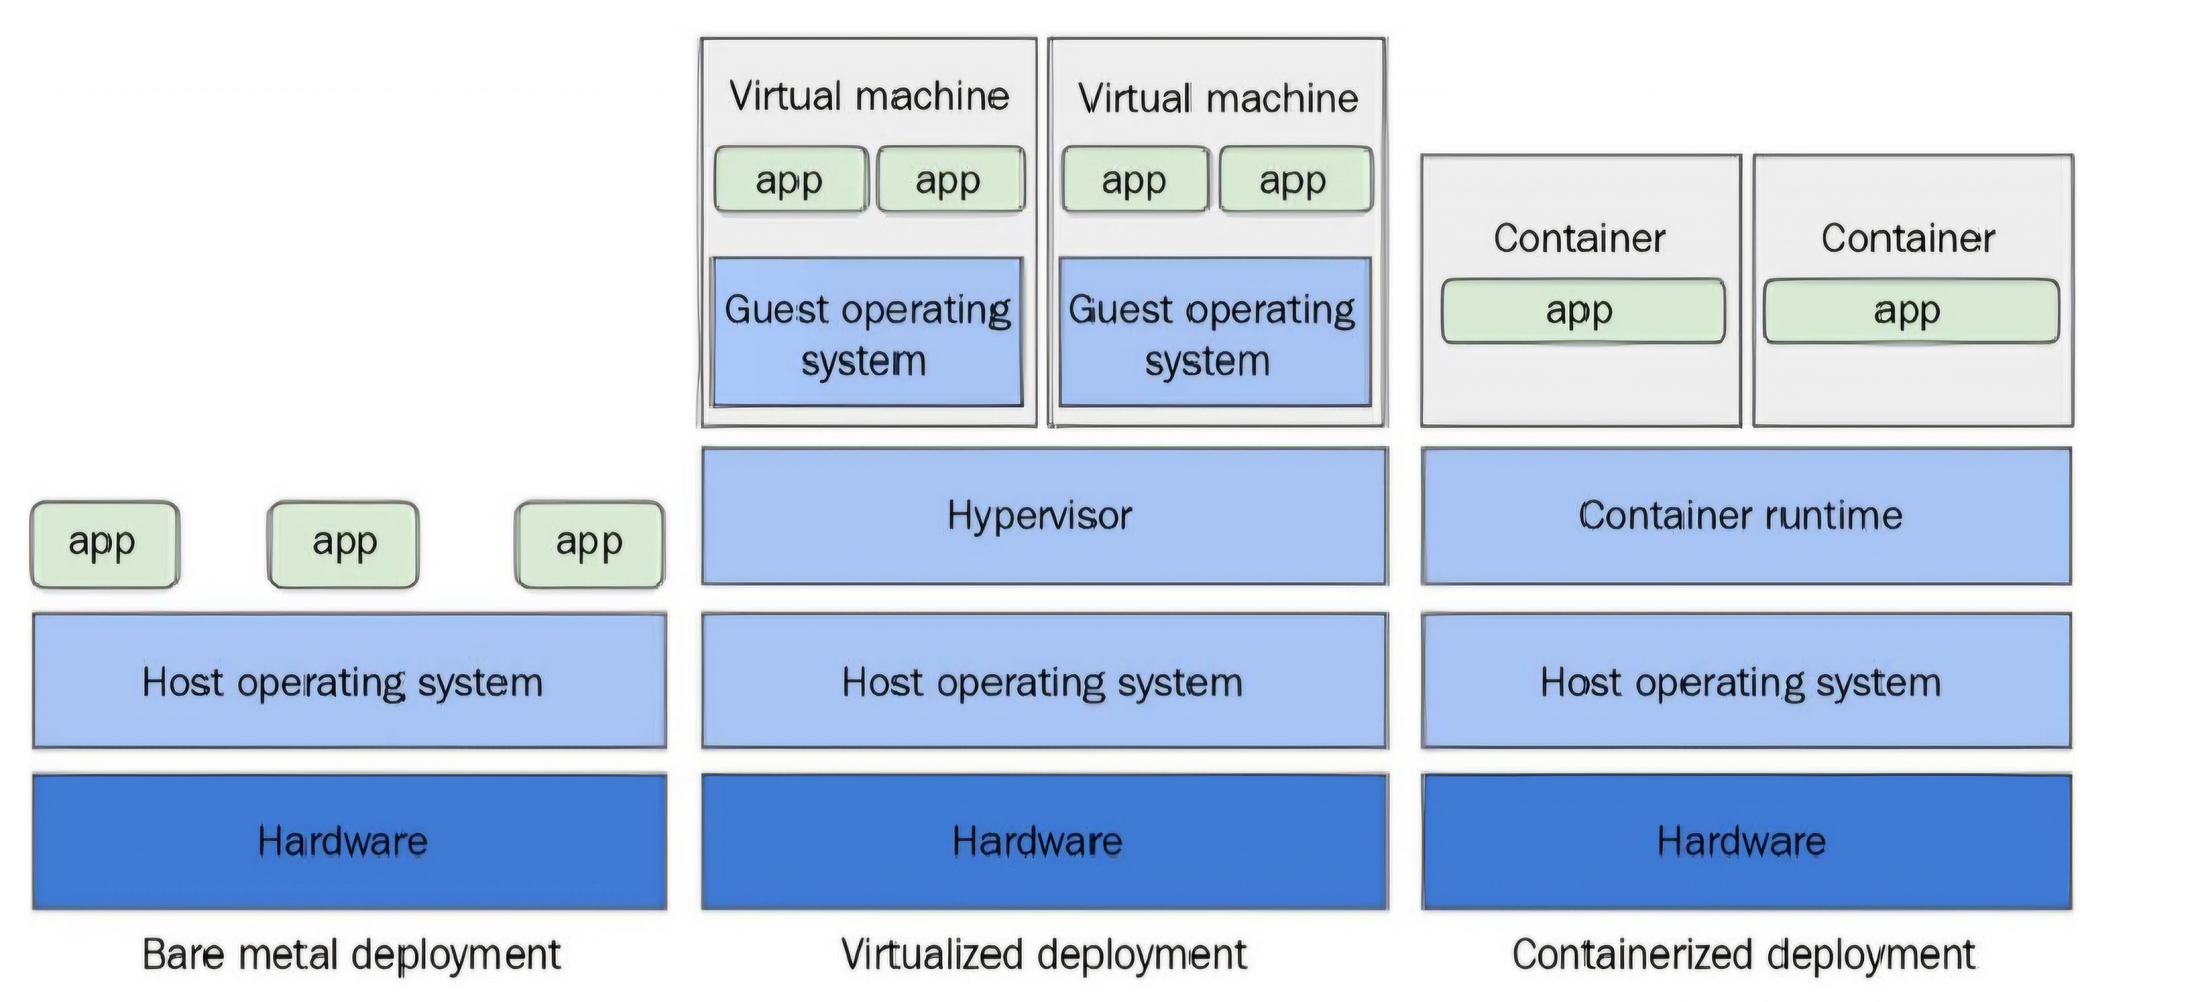
The differences between bare metal, virtualized, and container deployment

Slide 5
Docker and Container Images
Containers are packaged as Docker images, containing all necessary files for running an application.
A Dockerfile specifies how to build a container image with commands to install dependencies and run applications.
Docker images can be built, shared, and executed in any container runtime.
Example: Sample Dockerfile for setting up Python-based ML environment with Ubuntu.

Slide 6
Introduction to Kubernetes
Kubernetes, also known as K8s, is an open-source system for automating container management at scale.
It was designed to handle the complexity of managing hundreds or thousands of containers across clusters of servers.
Kubernetes provides built-in mechanisms for self-healing, scaling, and updating containerized applications.

Slide 7
Core Concepts of Kubernetes
Kubernetes operates using a master node (control plane) and multiple worker nodes.
The control plane handles tasks such as scheduling, state management, and communication between nodes.
Key components of the control plane include the API server, scheduler, controller, and etcd (data store).

Slide 8
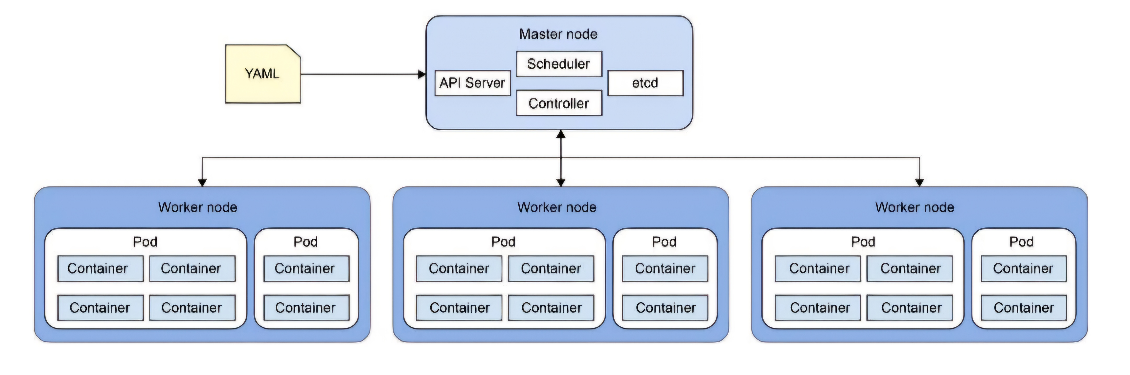
Kubernetes architecture

Slide 9
Kubernetes Namespaces
Namespaces provide a logical separation of resources within a Kubernetes cluster.
They allow different teams or applications to share a cluster without resource conflicts.
Namespaces also facilitate the use of quotas, limiting CPU and memory usage for specific environments.

Slide 10
Kubernetes Pods
A Pod is the smallest deployable unit in Kubernetes, containing one or more containers.
Pods share the same network namespace and storage, allowing containers inside them to communicate seamlessly.
Each Pod is assigned a unique IP address, ensuring containers within it can easily interact.

Slide 11
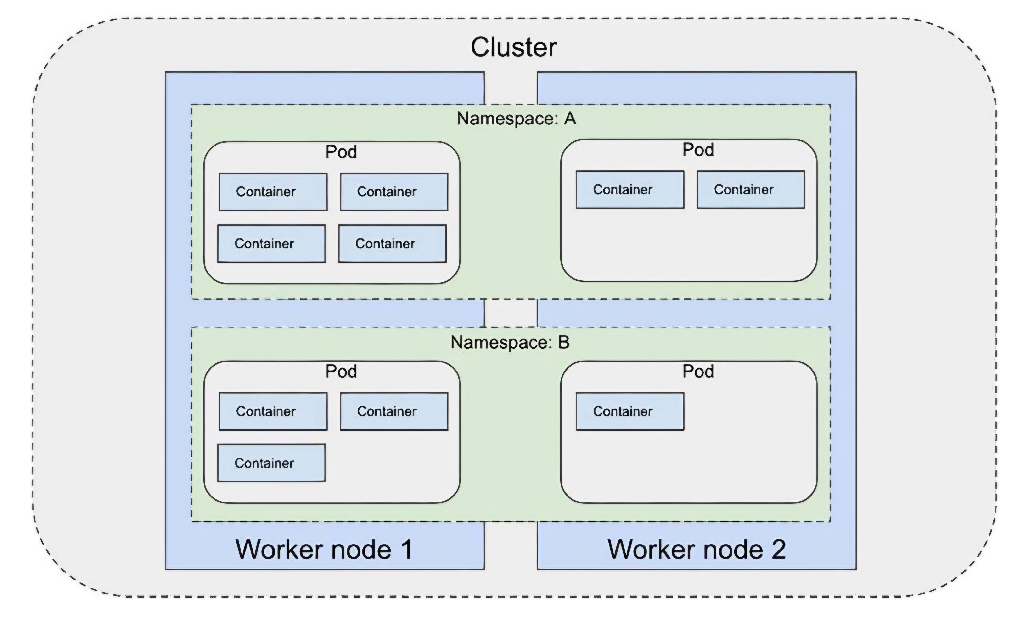
Namespaces,Pods,and containers

Slide 12
Kubernetes Deployment
A Deployment in Kubernetes defines how to create and manage Pods running containerized applications.
Deployment files (usually in YAML format) specify the container image, number of replicas, and other settings.
The Deployment controller monitors the state of Pods and replaces failed Pods to ensure the desired state is maintained.

Slide 13
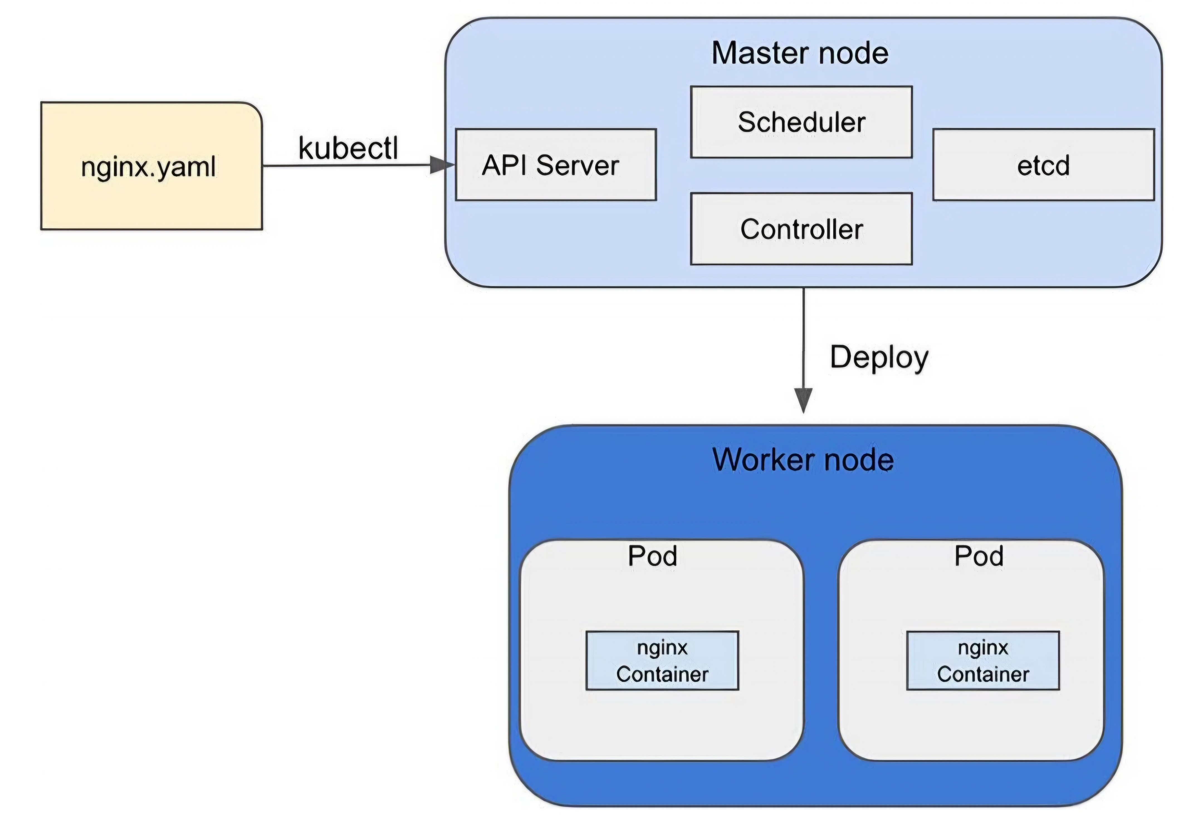
Creating an nginx deployment

Slide 14
Kubernetes Jobs
A Kubernetes Job creates Pods to run specific tasks and ensures they are completed.
Jobs are ideal for batch processes, such as data processing or ML model training tasks.
The controller recreates Pods in the event of failure to ensure the job is completed successfully.

Slide 15
Kubernetes Custom Resources & Operators
Kubernetes allows creating Custom Resources (CRs) for managing domain-specific applications.
Custom Resources are defined through CRDs (Custom Resource Definitions) and managed like built-in resources.
Operators are custom controllers designed to manage the lifecycle of CRs, automating complex workflows.

Slide 16
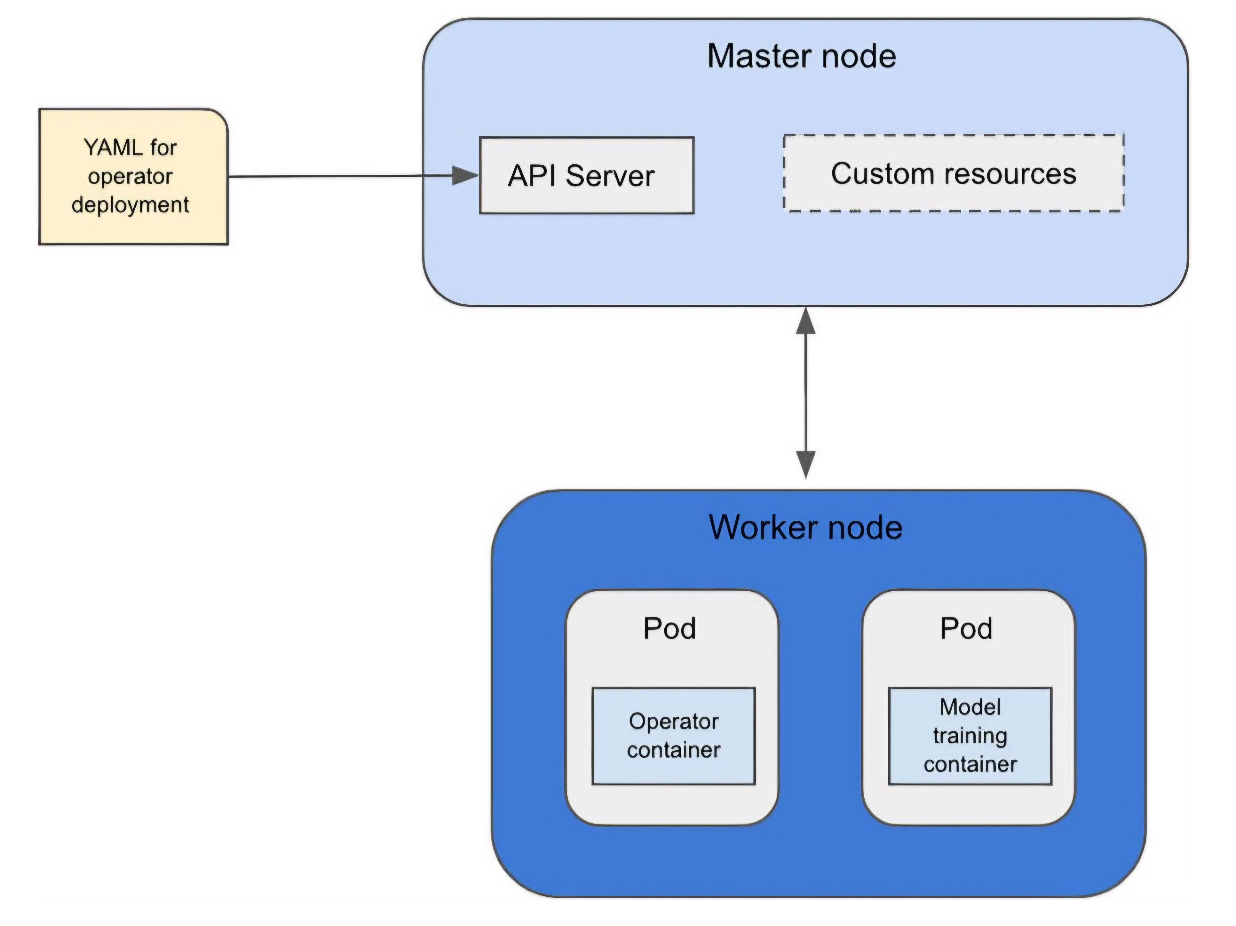
A Kubernetes custom resource and its interaction with the operator

Slide 17
Kubernetes Services
Services in Kubernetes expose a group of Pods as a single network endpoint.
They provide load balancing and ensure that traffic is routed to the correct set of Pods.
There are several types of services, including ClusterIP (internal communication), NodePort, and LoadBalancer (external access).

Slide 18
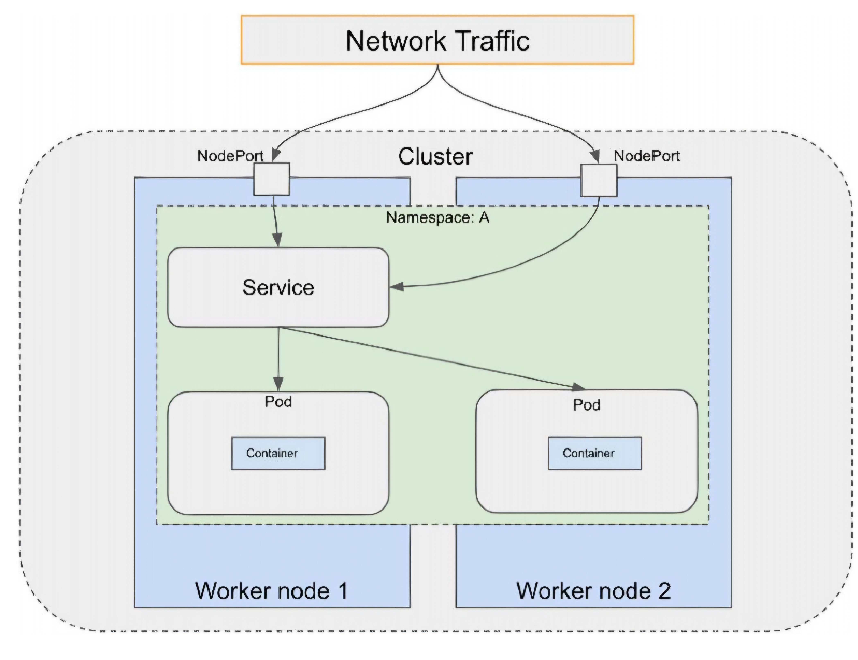
Accessing a Kubernetes Service via NodePort

Slide 19
Kubernetes Networking
Kubernetes provides a flat, private network for communication between Pods across the cluster.
Each Pod and node in the cluster is assigned a unique IP address for seamless communication.
To expose services externally, Kubernetes supports NodePort, LoadBalancer, and Ingress for routing traffic to services.

Slide 20
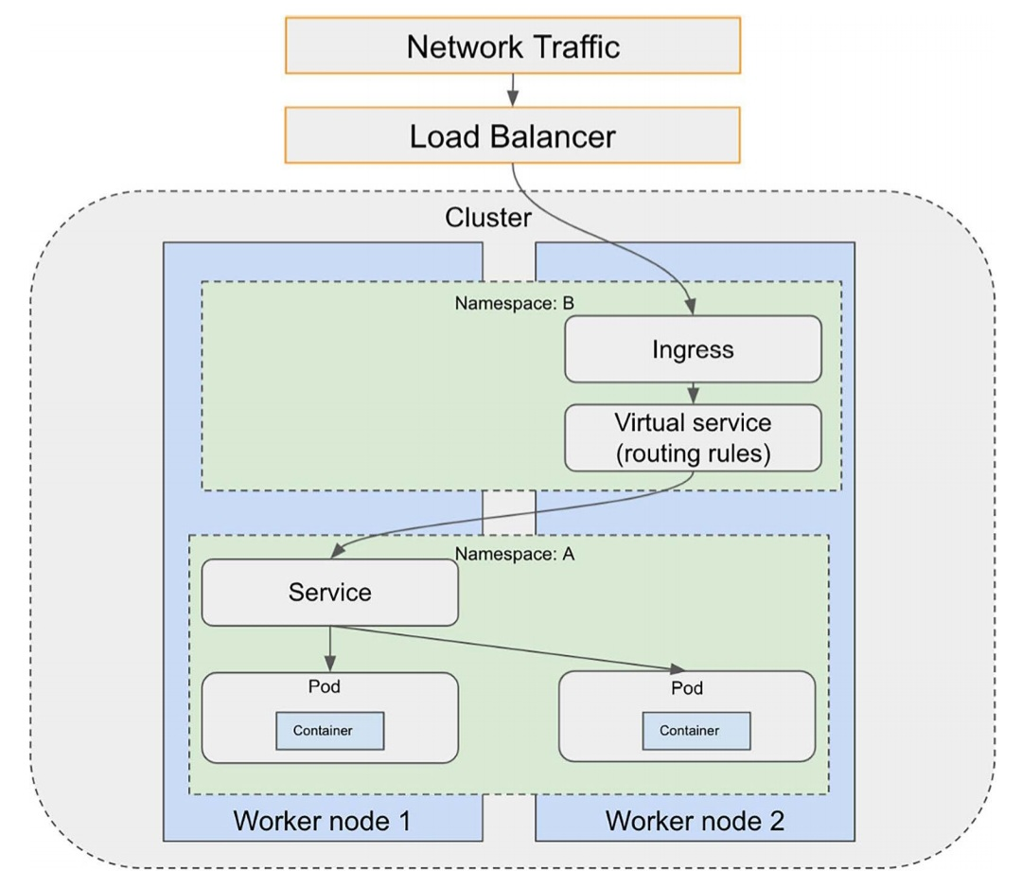
Accessing a Kubernetes service via Ingress

Slide 21
Istio and Service Mesh
Istio is an open-source service mesh that manages traffic between microservices in Kubernetes clusters.
It provides features like load balancing, traffic routing, and service-to-service authentication.
Istio’s sidecar proxy (Envoy) intercepts and manages traffic to and from Pods, enabling efficient network traffic control.

Slide 22
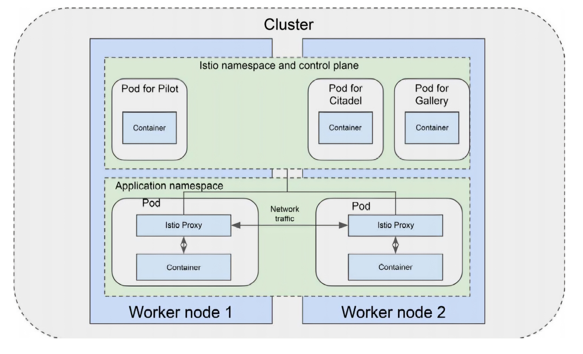
Istio architecture

Slide 23
Kubernetes Security
Security in Kubernetes includes network security, API authentication, and access control.
Kubernetes supports multiple authentication methods, including client certificates, HTTP basic authentication, and OpenID Connect.
Role-Based Access Control (RBAC) governs permissions at the user, namespace, or cluster level.

Slide 24
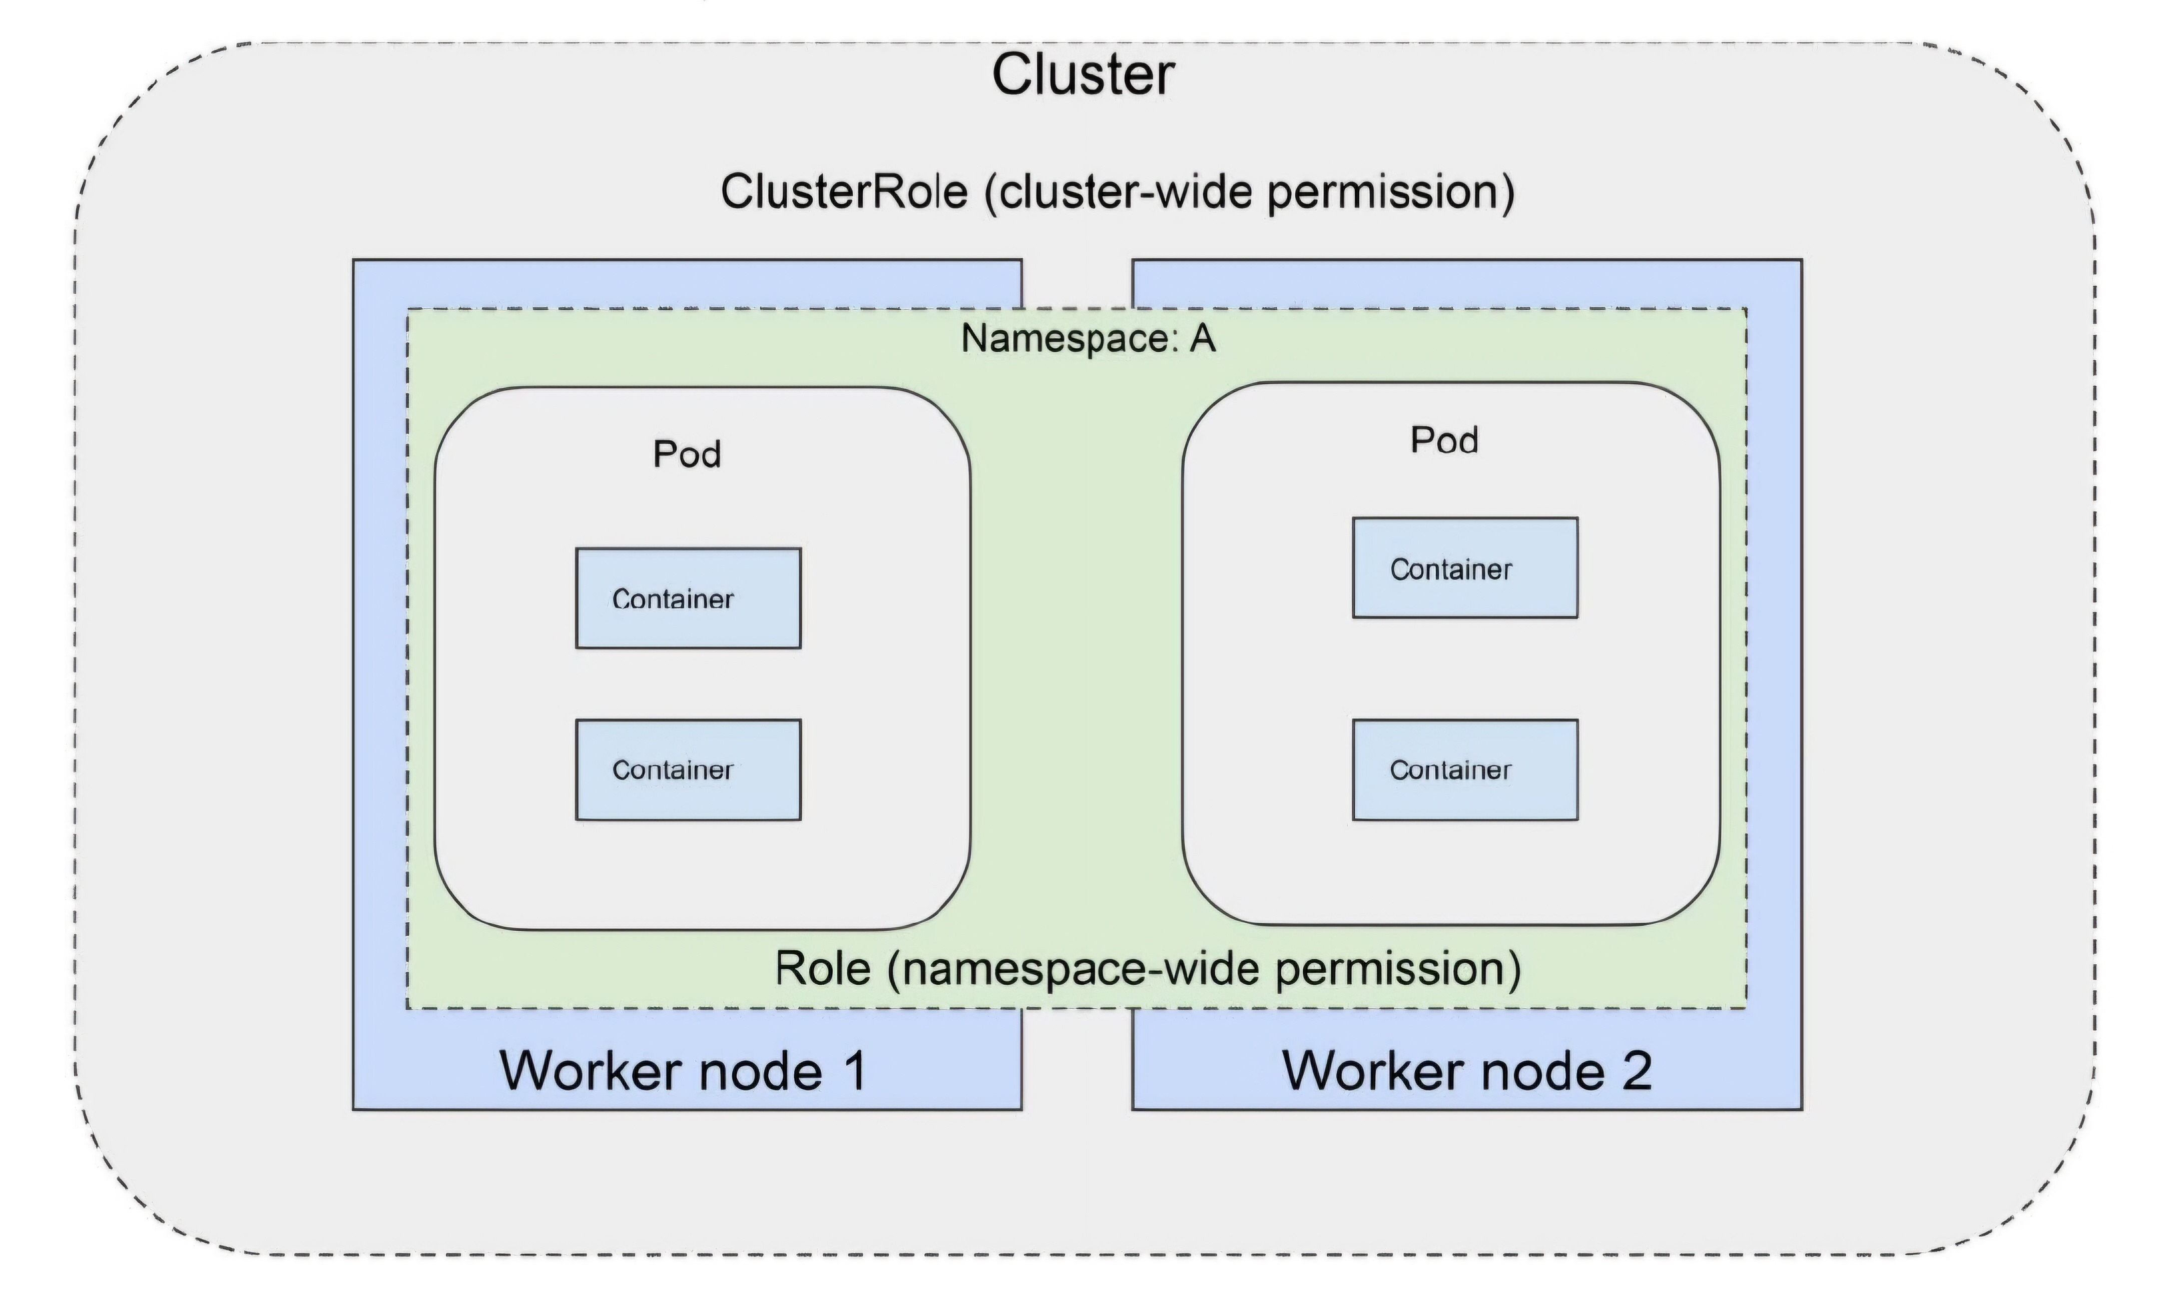
Role versus ClusterRole

Slide 25
Kubernetes Secrets Management
Kubernetes Secrets store sensitive information such as passwords, tokens, and API keys.
Secrets can be injected into Pods via environment variables or mounted as files within the container.
By default, Secrets are stored unencrypted, but encryption at rest can be enabled for additional security.

Slide 26
Conclusion
Kubernetes provides a scalable, flexible infrastructure for running containerized ML workloads.
With its core features like Pods, Deployments, Services, and networking, Kubernetes ensures seamless orchestration and management of ML environments.
Advanced features like Istio and Operators further extend Kubernetes’ capabilities, making it ideal for modern ML and microservices architectures.

